Slide 1

H-1B Disclosure Data ANALYSIS & VISUALIZATION
Bhavesh Thakkar

Slide 2
Objective
The primary objective of this analysis is to gain insights of wage related to H1B for various categories & identifying the relationship between other variables and reasons for H1B rejection.
Classification of H1B wages according to various categories
Comparing median salary wage according to the occupation
Comparing salaries across different states
Comparing the prevailing wages to the actual wage given by the employer
Identifying reasons for H1B rejects
Identifying top 20 Employers sponsoring H1B
Comparing H1B acceptance vs the company sponsoring visa
Comparing H1B acceptance to whether there is a H1B Dependent while applying for Visa

Slide 3
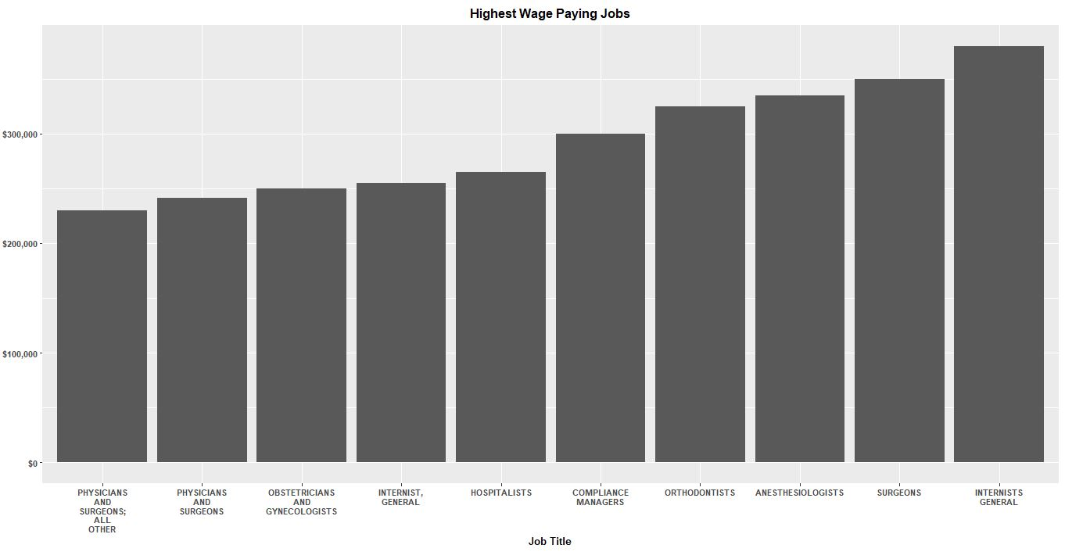
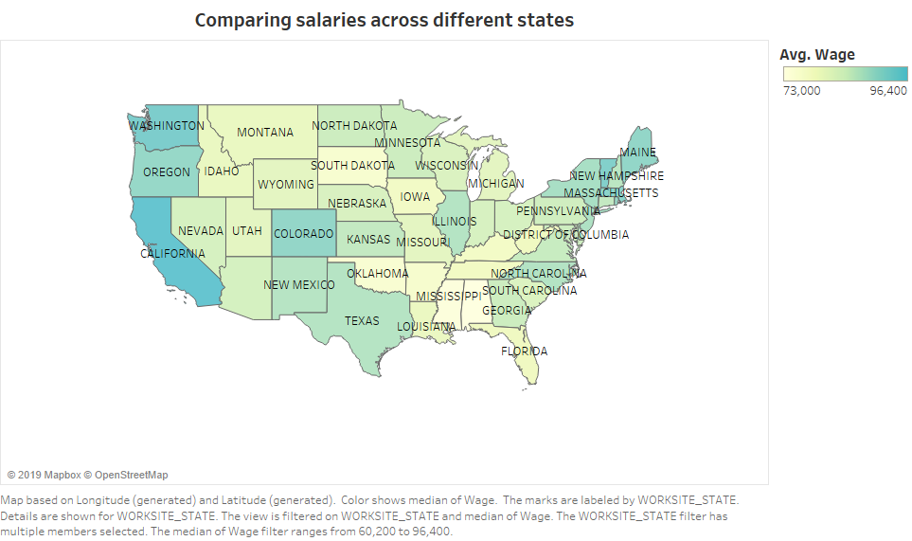
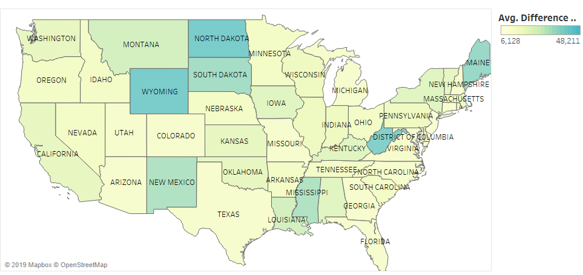
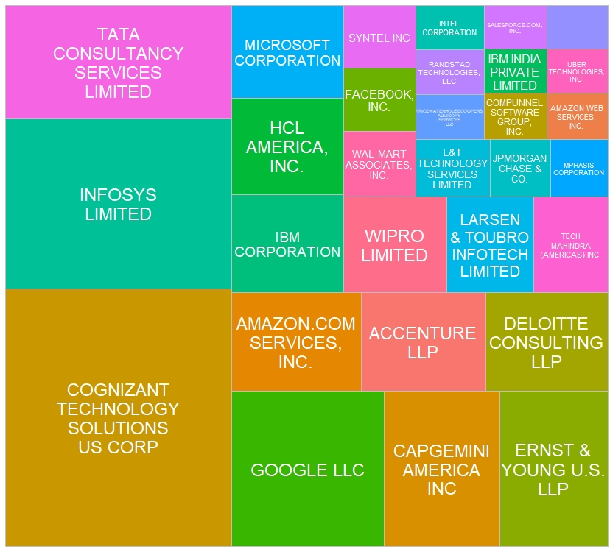
Top 20 H1B Sponsoring Companies

Slide 4
